Slide 1

Student Name: Yousef Abu Ali
Student Id: 21110294
Section number: 2

Slide 2
Overview

Slide 3
Historical background
1733
The biggening of probabilistic data analysis from “Bayes Theorem” by Thomas Bayes
1805
Adrien Marie and Carl Friedrich developed regression analysis, which also was a foundation for data mining.
1889
Herman Hollerith improved data processing punch card which allowed machines to read large datasets and analyze them quickly
1936
Alan Turing came up with Universal machine that is capable of anu computation
1950s-1960s
Statistical methods such as decision tress and linear programming were used
1970s
The rise of rational data bases and Structured Query Language (SQL), which helped in data storage and retrieval.
1980s
1990s
The term data mining was introduced.
1996
A conference for KDD was held for the first-time showing data mining as a special field.
Late 1990s
21st Century
(Present Day)
The Knowledge Discovery in Databases was a field that focuses on obtaining valuable information from data.
there were advancements in machine learning algorithms such as neural network.
Data mining was very popular due to the development in computing power, storage capabilities, and its various applications in business.
Evolution of data mining algorithms and techniques continuously.
Big Data analytics and being able to handle massive datasets from multiple sources and fields.
Notes:
https://matthewrhoads.com/2017/10/14/blog-post-title-2/. (Navigating the Present and Future of Education, 2017)

Slide 4
Historical background
1733
The biggening of probabilistic data analysis from “Bayes Theorem” by Thomas Bayes
1805
Adrien Marie and Carl Friedrich developed regression analysis, which also was a foundation for data mining.
1889
Herman Hollerith improved data processing punch card which allowed machines to read large datasets and analyze them quickly
1936
Alan Turing came up with Universal machine that is capable of anu computation
1950s-1960s
Statistical methods such as decision tress and linear programming were used
1970s
The rise of rational data bases and Structured Query Language (SQL), which helped in data storage and retrieval.
1980s
1990s
The term data mining was introduced.
1996
A conference for KDD was held for the first-time showing data mining as a special field.
Late 1990s
21st Century
(Present Day)
The Knowledge Discovery in Databases was a field that focuses on obtaining valuable information from data.
there were advancements in machine learning algorithms such as neural network.
Data mining was very popular due to the development in computing power, storage capabilities, and its various applications in business.
Evolution of data mining algorithms and techniques continuously.
Big Data analytics and being able to handle massive datasets from multiple sources and fields.
2005
2006-2010
The invention of technologies such as Hadoop and spark.
Increase use of machine learning algorithms and rise in the number of open-source tools. As well as the use of data in data mining.
Data mining included advancement in the fields of healthcare, education, and web.
Especially large volume of data related to education, showed the need for advanced data mining methods.
A release of the second addition of data mining, showing description for the update in data mining techniques and applications.
A study was conducted on outlier detection and one-class classification algorithms, helping in the advancement of data mining techniques
2015
Notes:
https://matthewrhoads.com/2017/10/14/blog-post-title-2/. (Navigating the Present and Future of Education, 2017)

Slide 5
Historical background
1980s
1990s
The term data mining was introduced.
1996
A conference for KDD was held for the first-time showing data mining as a special field.
Late 1990s
21st Century
(Present Day)
The Knowledge Discovery in Databases was a field that focuses on obtaining valuable information from data.
there were advancements in machine learning algorithms such as neural network.
Data mining was very popular due to the development in computing power, storage capabilities, and its various applications in business.
Evolution of data mining algorithms and techniques continuously.
Big Data analytics and being able to handle massive datasets from multiple sources and fields.
2005
2006-2010
The invention of technologies such as Hadoop and spark.
Increase use of machine learning algorithms and rise in the number of open-source tools. As well as the use of data in data mining.
Data mining included advancement in the fields of healthcare, education, and web.
Especially large volume of data related to education, showed the need for advanced data mining methods.
A release of the second addition of data mining, showing description for the update in data mining techniques and applications.
A study was conducted on outlier detection and one-class classification algorithms, helping in the advancement of data mining techniques
2015
Notes:
https://matthewrhoads.com/2017/10/14/blog-post-title-2/. (Navigating the Present and Future of Education, 2017)
(PDF) Educational data mining: A survey from 1995 to 2005 (researchgate.net)

Slide 6
Theoretical Background
Probability and statistics
Data mining involves understanding huge datasets with wrong or incomplete data. Using probability theory tools and statistical learning theory we can fix datasets and use data mining algorithms to understand this data.
Optimization and algorithm design
Optimization techniques helps in designing sufficient algorithms that can find insights, and search for an optimal solutions.
Machine learning algorithms and Artificial intelligence
Many data mining algorithms are built on machine learning techniques such as support vector machines, decision trees, and neural networks. These algorithms help in learning from data ,making predictions and classifying data points.
Artificial intelligence uses tools that helps in building intelligent systems that can learn and improved performance over time which leads to advanced data mining techniques and applications.
Database management and Data Preprocessing
Data management and preprocessing are very important to have successful results for data mining. Ex(Data structures, indexing, feature selection, cleaning etc.) helps in improving the performance of data mining algorithms.
Information theory
Information theory provides important tools that helps in measuring the content within data to assess it relevance and usefulness (extracted data)
Data mining combines its theoretical foundation from mathematics, statistics, computer science, as well as information theory.

Slide 7
Theoretical Background
Apache spark
IT is powerful and open-source tool used for huge scale data processing. It provides speed and flexibility however it needs technical expertise such as coding, and it is not beginner friendly. It could be used for fraud detection and personalized recommendations.
KNIME
A user-friendly platform that has a drag and drop interface, it requires no coding and has prebuilt models and data visualization capabilities. However, it has limited flexibility and suitable for complex tasks. It is used for data preprocessing, basic data mining workflows, and exploring relationships through visualization.
Orange
An open-source tool which has a strong data visualization capabilities and it includes various machine learning algorithms. However, it's not suitable for complex tasks. It could be used for exploring and cleaning data, building and testing some classification models, and visualizing relationships.
RapidMiner
Python
Google Cloud Platform
A tool that is suitable for people with different skills and combines visual interface with prebuilt models
Flexible and powerful tool but requires programming knowledge
A cloud based platform that includes pre built models and tools hi
Data Mining Tools
Probability and statistics
Data mining involves understanding huge datasets with wrong or incomplete data. Using probability theory tools and statistical learning theory we can fix datasets and use data mining algorithms to understand this data.
Optimization and algorithm design
Optimization techniques helps in designing sufficient algorithms that can find insights, and search for an optimal solutions.
Information theory
Information theory provides important tools that helps in measuring the content within data to assess it relevance and usefulness (extracted data)
Database management and Data Preprocessing
Data management and preprocessing are very important to have successful results for data mining. Ex(Data structures, indexing, feature selection, cleaning etc.) helps in improving the performance of data mining algorithms.
Machine learning algorithms and Artificial intelligence
Many data mining algorithms are built on machine learning techniques such as support vector machines, decision trees, and neural networks. These algorithms help in learning from data ,making predictions and classifying data points.
Artificial intelligence uses tools that helps in building intelligent systems that can learn and improved performance over time which leads to advanced data mining techniques and applications.
Data mining combines its theoretical foundation from mathematics, statistics, computer science, as well as information theory.
Notes:
A Unified Theoretical Framework for Data Mining
Khan, D.M., Mohamudally, N. and Babajee, D.K.R. (2013). A Unified Theoretical Framework for Data Mining. Procedia Computer Science, [online] https://www.sciencedirect.com/science/article/pii/S1877050913001488

Slide 8
Theoretical Background
Apache spark
It is powerful and open-source tool used for huge scale data processing. It provides speed and flexibility however it needs technical expertise such as coding, and it is not beginner friendly. It could be used for fraud detection and personalized recommendations.
KNIME
A user-friendly platform that has a drag and drop interface, it requires no coding and has prebuilt models and data visualization capabilities. However, it has limited flexibility and suitable for complex tasks. It is used for data preprocessing, basic data mining workflows, and exploring relationships through visualization.
Orange
An open-source tool which has a strong data visualization capabilities and it includes various machine learning algorithms. However, it's not suitable for complex tasks. It could be used for exploring and cleaning data, building and testing some classification models, and visualizing relationships.
RapidMiner
Python
Google Cloud Platform
A tool that is suitable for people with different skills and combines visual interface with prebuilt models and can handle large datasets and complex tasks. However, it requires programming knowledge. It could be used to test and compare multiple algorithms to find the best result.
Flexible and powerful tool for complex tasks, it has large community and a huge amount of libraries. However, it requires programming experience. It is used for feature engineering, preparing data, visualization, and building complex machine learning models.
A cloud based platform that is accessible from everywhere, it offers pre trained models and tools used for certain tasks, and it's able to handle huge data. However, it is considered expensive and requires technical expertise specially for setup and configuration. It is used to build machine learning models, run huge data analysis tasks accessing modules used for image recognition and sentiment analysis.
Data Mining Tools
Probability and statistics
Data mining involves understanding huge datasets with wrong or incomplete data. Using probability theory tools and statistical learning theory we can fix datasets and use data mining algorithms to understand this data.
Data mining combines its theoretical foundation from mathematics, statistics, computer science, as well as information theory.
Optimization and algorithm design
Optimization techniques helps in designing sufficient algorithms that can find insights, and search for an optimal solutions.
Information theory
Information theory provides important tools that helps in measuring the content within data to assess it relevance and usefulness (extracted data)
Database management and Data Preprocessing
Data management and preprocessing are very important to have successful results for data mining. Ex(Data structures, indexing, feature selection, cleaning etc.) helps in improving the performance of data mining algorithms.
Machine learning algorithms and Artificial intelligence
Many data mining algorithms are built on machine learning techniques such as support vector machines, decision trees, and neural networks. These algorithms help in learning from data ,making predictions and classifying data points.
Artificial intelligence uses tools that helps in building intelligent systems that can learn and improved performance over time which leads to advanced data mining techniques and applications.
Notes:
https://careerfoundry.com/en/blog/data-analytics/best-data-mining-tools/. (careerfoundry.com, n.d.)

Slide 9
Organization

Slide 10



Organization
Orange Jordan is a public network telephone operator. They provide clients with phone and internet services.
Contact Information:
Name : Samer Ismail ‘Data science expert’
Phone number: 0776801524
LinkedIn Profile: https://www.linkedin.com/in/samerismail

Slide 11
Traditional and modern approaches
Orange uses a combination of traditional and advanced technologies to collect data: cloud storage, data warehouse, data lakes.
"Our advanced data analytics and ML models give a new perspective and uncover the hidden patterns that cannot be seen without data mining techniques"
Data mining models are one of the key inputs which are taken into consideration during management meetings.

Slide 12

Building blocks of Traditional Approach
Tools used for developing data mining projects:
"SAS Enterprise Miner" and "SAS Enterprise Guide"
passive data collection methods
Data warehousing played an important role, by focusing on Oracle databases.
This formed the base for data mining at Orange, and provided
Solid ground for good analysis and decision-making.

Slide 13
Building blocks of Modern Approach
Using new tools such as Python and Google cloud are the primary tools in their modern approaches.
Using active data collection method
Utilizing real time collection method from network devices and customer interactions
Collecting data from multiple new sources such as social media, IOT and Orange chatbots.
The modern approaches provides flexibility. And ensures that data mining approaches are effective in meeting new demands.

Slide 14
Benefits of Data mining at orange
Provide personal customer interaction
Provide targeted recommendations
Identify customer needs
Resolve customer issues more quickly
Identify new market opportunities
Develop innovative product and services
Improve existing offering

Slide 15

Text mining

Slide 16

What is Text Mining
Text mining is a process that involves turning normal unstructured text into a structured format to find useful patterns and insights
Notes:
https://www.ibm.com/topics/text-mining

Slide 17
Examples
Market Research : finding what people value
Preventing spams through spam detection
Monitoring social media
Customer feedback analysis
Risk management
Cybercrime prevention
Notes:
https://www.zencos.com/blog/text-mining-examples-advanced-analytics

Slide 18
How Algorithms, techniques, methods and approaches works
Data Preparation:
Data preparation in text mining includes removing noise, errors, and applying standardization methods (e.g., removing punctuation, lowercase, remove stop words, tokenization, stemming)
Feature engineering:
This involves feature extraction (finding and extracting information from text (e.g.TF-IDF)
Modeling
Choose the text mining algorithm that fits the required task (e.g. classification, clustering).
Give the preprocessed data for the model to learn patterns.
Evaluating the model
Interpretation: Using the train models for real application, that includes sentiment analysis, spam detecting, or even provide recommendations
Notes:
Whorton, C. (2020). Pipeline For Text Data Pre-processing. [online] Medium. Available at: https://towardsdatascience.com/pipeline-for-text-data-pre-processing-a9887b4e2db3

Slide 19

Text mining methods
Term-Based Method: analyze the documents based on terms, each term has a weight, the challenge is having multiple meanings for the same word or same meaning for multiple words
Phrase based method: analyze the documents based on phrases(collection of terms) as they provide more information, however it could be challenging especially in redundant phrases (very, very good)
Concept based method: this method focus on the defying the overall theme of a document instead of focusing on individual terms. (medical, sports, educational)
Pattern taxonomy method: analyze the documents based on certain patterns forming a tree structure. These patterns help in improving accuracy by being specific. (customer feedback – sentiments)
Notes:
Editorial (n.d.). Text mining methods and techniques: The beginner’s guide. [online] roboticsbiz.com. Available at: https://roboticsbiz.com/text-mining-methods-and-techniques-the-beginners-guide/.

Slide 20

Text mining techniques
Information extraction: extracting specific information(such as names, organizations, and locations) as structured format from unstructured or semi structured texts.
Information retrieval: finding relevant information from multiple sources, in an unstructured format.
Text categorization: giving categories to text document. Such as categorizing knows the articles, or classifying emails (spam or not spam)
Document clustering: grouping similar documents together based on their content, in order to ensure that related information are close to each other.
Text visualization: representing text information in a visual way to make it easier to search for specific things.
Notes:
Editorial (n.d.). Text mining methods and techniques: The beginner’s guide. [online] roboticsbiz.com. Available at: https://roboticsbiz.com/text-mining-methods-and-techniques-the-beginners-guide/.

Slide 21

TF-IDF
The TF-IDF(term frequency-inverse document frequency) it's a statistical number, which combines (term frequency) which measures how often a certain term appears in a document, and the (inverse document frequency) which measures how unique is a certain term across all the documents.
It is used to show the importance of a certain word to a document. It is used as wight in information retrieval in text mining.
The value of the TFIDF increases each time a certain word appears in a document the more often it appears the higher the value of the TF-IDF.
Notes:
GeeksforGeeks. (2021). Understanding TF-IDF (Term Frequency-Inverse Document Frequency). [online] Available at: https://www.geeksforgeeks.org/understanding-tf-idf-term-frequency-inverse-document-frequency/.

Slide 22
Example
Document1: “The cat chased the fox”
Document 2:”The cat is sleeping”
Document 3:”The fox ate the chickens”
I will calculate TF-IDF for the cat in document 1:
TF = 1/5
IDF= log ( 3/ 2)
TF-IDF= TF * IDF = 0.0352

Slide 23
Graph Mining

Slide 24

What is Graph Mining?
Graph mining is the process of finding patterns and relationships in graphs. Using graph mining we can find relationship that will help us in clustering the graph sets, find connection between the graph sets, or characterizing graphs. Predicting these patterns or trends can help us in building models to enhance real life applications (example : social media, fraud detection).
Notes:
GeeksforGeeks. (2021). Data Mining Graphs and Networks. [online] Available at: https://www.geeksforgeeks.org/data-mining-graphs-and-networks/.

Slide 25
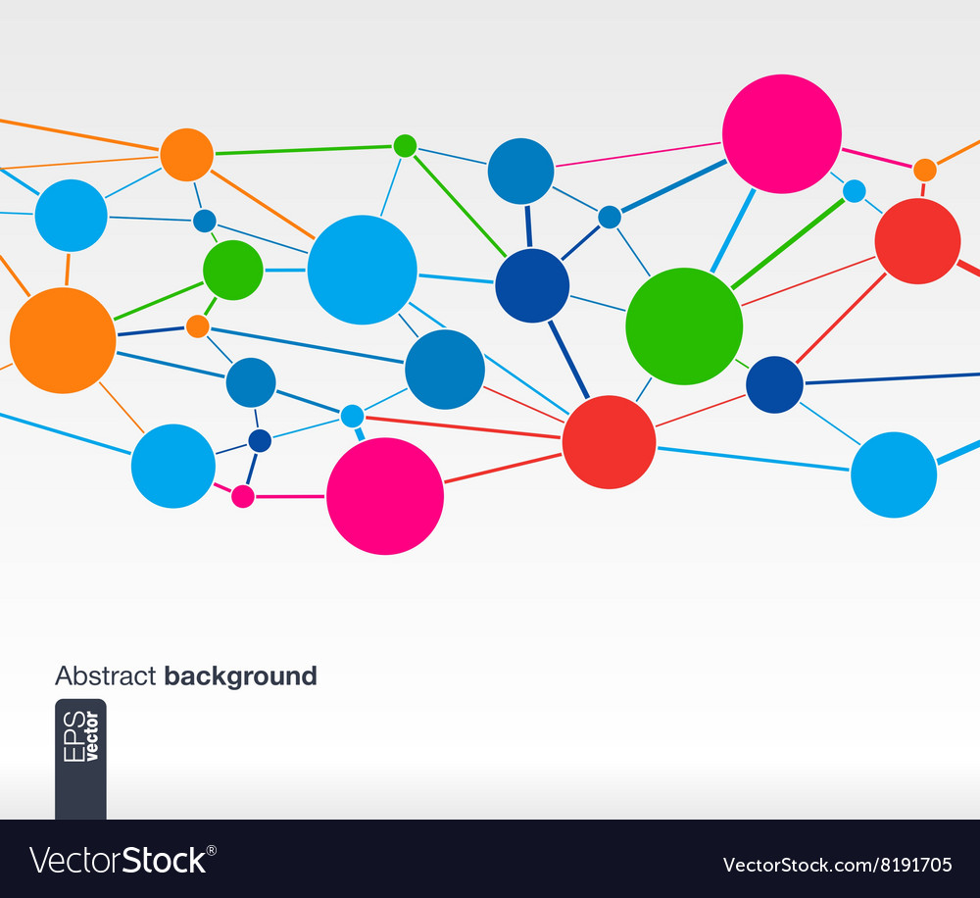
Examples
Graph mining is used in social network to detect users when to react with each other frequently.
Graph mining is used in citation networks order to identify the nodes that play important roles in terms of influence, our connectivity.(Influential authors)
Graph mining is used in analyzing paths in a graph to understand a flow through a network. Such as in transportation network, graph mining helps in finding the best path between different locations (route optimization).
Graph mining is used in recommendation systems by finding connections between users. For example, understanding connection between different users in a movie recommendation system to provide better movie suggestions.
Notes:
blog.katanagraph.com. (n.d.). The Language of Graph: Graph Mining. [online] Available at: https://blog.katanagraph.com/the-language-of-graph-graph-mining#:~:text=Graph%20mining%20describes%20the%20process%20of%20identifying%2C%20quantifying%2C

Slide 26
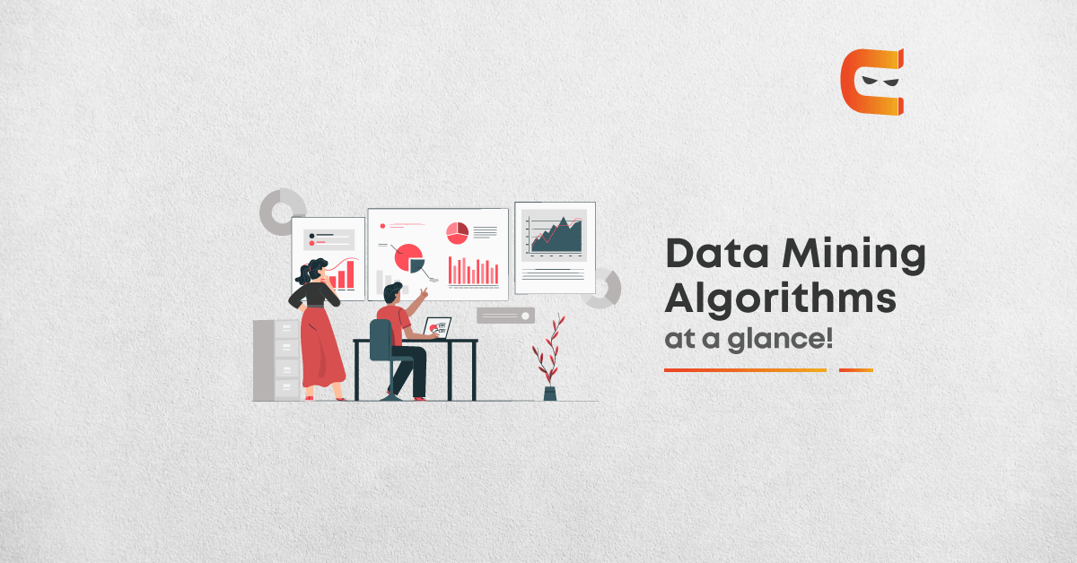

Slide 27
How graph mining algorithms work?
The main goal of graph mining algorithms is to analyze the structure of a graph and find the relationships to discover insights and important information.
The operation of graph mining algorithms start by creating a representation of the data in the graph. It then represent this data in a form of a matrix or a graph database. Once the data from the graph are represented, the algorithms are used to extract the information we need. These algorithms perform mathematical and computational techniques to find hidden patterns within networks.
Representing data (Nodes and edges)
Exploring graph
Ex: find relationships
Identify patterns
Perform cluster to similar groups
Detecting anomaly (unusual behavior)
Graph summarization
Applying specific measures (Ex: user's degree centrality)
Notes:
Gudes, E. (n.d.). Graph and Web Mining - Motivation, Applications and Algorithms. [online] Available at: https://www.cs.helsinki.fi/u/langohr/graphmining/slides/chp1.pdf

Slide 28
Programming languages and tools in industry
1. Pyhton: programming language used in graph analysis, and contains libraries that helps in graph mining:
2. R: another programming language that's used for graph analysis:
Statnet: packages used in network analysis and visualization.
(igraph: a library available in R and Python, provide wide range of tools for creating, visualizing, and performing analysis on graphs)
3. Java: a programming language used in large scale processing for graphs.
NetworkX: library used for creating, manipulating, and understand structure, and functions of networks.
4. C++: includes libraries for graph mining such as boost graph, used for graph algorithms and data structure.
It includes graph mining libraries such as JGraphT as well as Graph Stream.

Slide 29

My Application

Slide 30
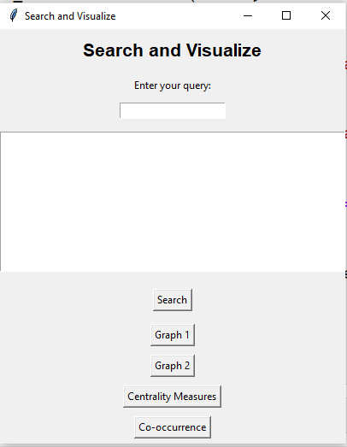
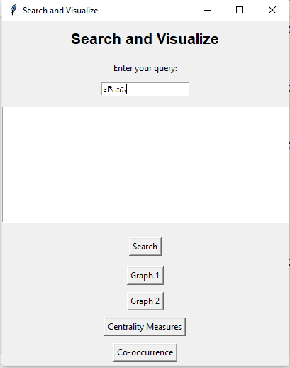

Slide 31
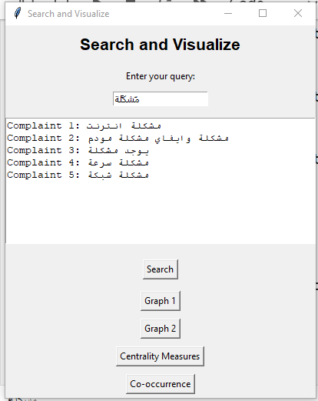

Slide 32
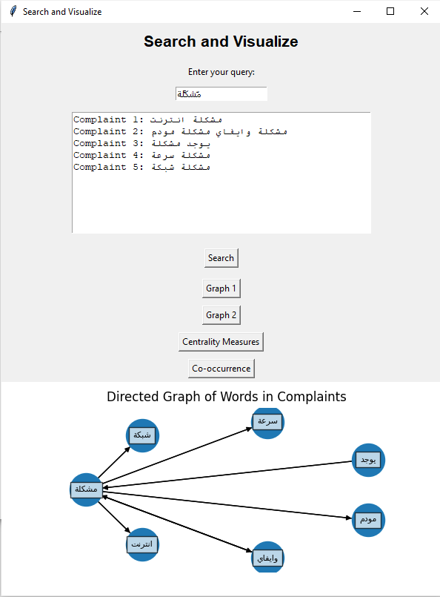

Slide 33
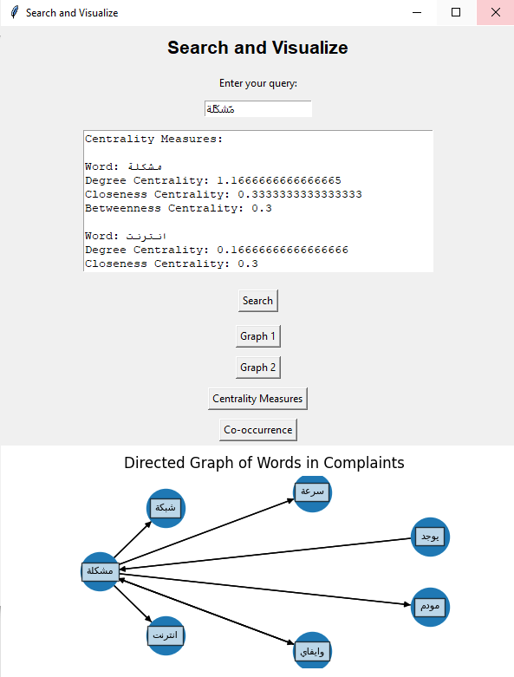

Slide 34
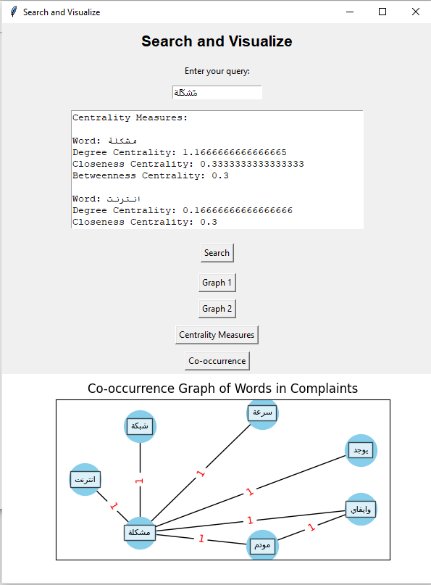

Slide 35
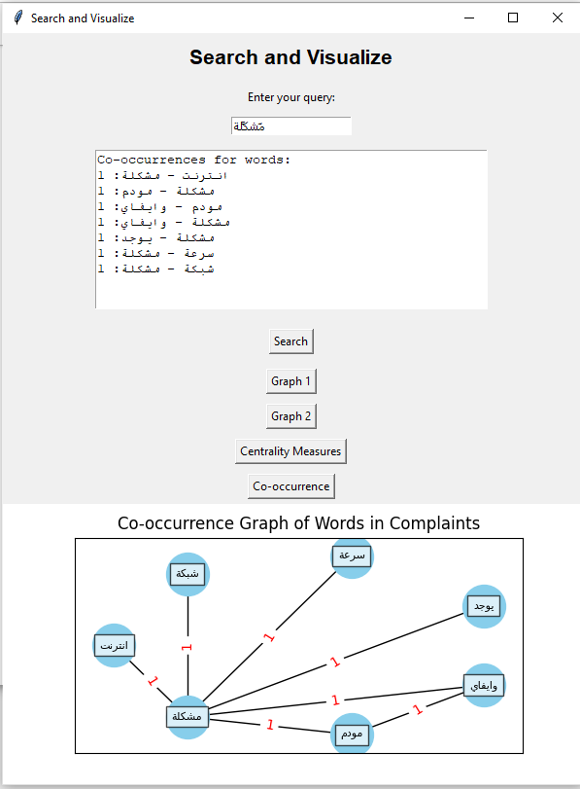

Slide 36
Thank you

Slide 37

References
IBM (2023). What is Text Mining? | IBM. [online] www.ibm.com. Available at: https://www.ibm.com/topics/text-mining.
Anon, (n.d.). The History Of Data Mining - Dataconomy. [online] Available at: https://dataconomy.com/2016/06/16/history-data-mining/.
Zencos.com. (2023). 5 Real World Text Mining Examples You Can Apply to Your Data. [online] Available at: https://www.zencos.com/blog/text-mining-examples-advanced-analytics
Navigating the Present and Future of Education. (2017). History of Data Mining. [online] Available at: https://matthewrhoads.com/2017/10/14/blog-post-title-2/.
www.kdd.org. (n.d.). SIGKDD. [online] Available at: https://www.kdd.org/.
Khan, D.M., Mohamudally, N. and Babajee, D.K.R. (2013). A Unified Theoretical Framework for Data Mining. Procedia Computer Science, [online] https://www.sciencedirect.com/science/article/pii/S1877050913001488
careerfoundry.com. (n.d.). The Top 7 Data Mining Tools of 2022 [+ Pros & Cons of Each]. [online] Available at: https://careerfoundry.com/en/blog/data-analytics/best-data-mining-tools/.
Whorton, C. (2020). Pipeline For Text Data Pre-processing. [online] Medium. Available at: https://towardsdatascience.com/pipeline-for-text-data-pre-processing-a9887b4e2db3

Slide 38
References
Editorial (n.d.). Text mining methods and techniques: The beginner’s guide. [online] roboticsbiz.com. Available at: https://roboticsbiz.com/text-mining-methods-and-techniques-the-beginners-guide/.
GeeksforGeeks. (2021). Understanding TF-IDF (Term Frequency-Inverse Document Frequency). [online] Available at: https://www.geeksforgeeks.org/understanding-tf-idf-term-frequency-inverse-document-frequency/.
GeeksforGeeks. (2021). Data Mining Graphs and Networks. [online] Available at: https://www.geeksforgeeks.org/data-mining-graphs-and-networks/.
blog.katanagraph.com. (n.d.). The Language of Graph: Graph Mining. [online] Available at: https://blog.katanagraph.com/the-language-of-graph-graph-mining#:~:text=Graph%20mining%20describes%20the%20process%20of%20identifying%2C%20quantifying%2C
Gudes, E. (n.d.). Graph and Web Mining - Motivation, Applications and Algorithms. [online] Available at: https://www.cs.helsinki.fi/u/langohr/graphmining/slides/chp1.pdf

